Slide 1

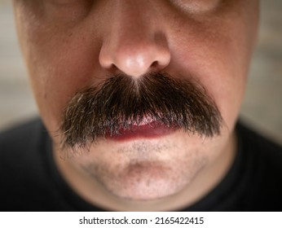
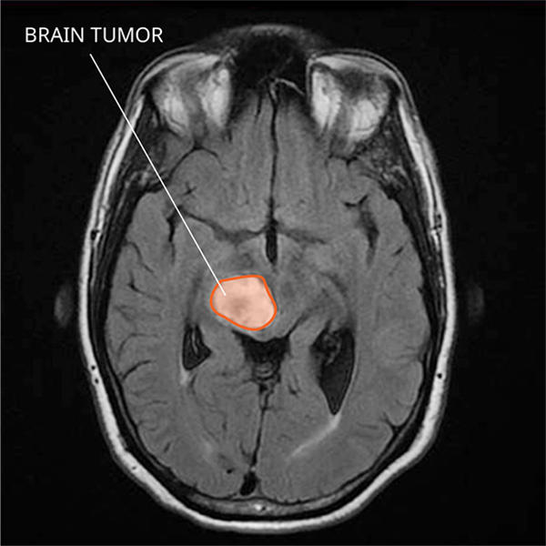
=
A Visual Analogy: Moustaches as Medical Markers
(Shutterstock, 2015)
(National Cancer Institute, 2024)
Notes:
Thank you Charlie,
*Click*
Picture a moustache as a visual marker for a specific brain disease in an MRI scan; one that is too intricate to discern if such abnormality was in-fact a potential indicator of disease.

Slide 2

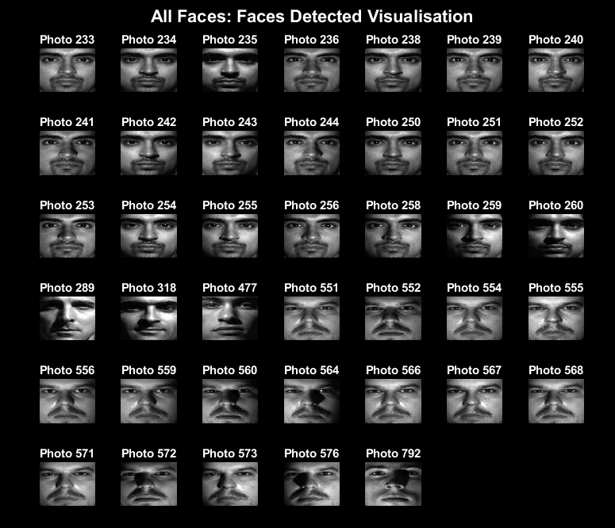
First Sample: All Faces
1000 face photos
Accuracy: 97.4%
Notes:
We tested our moustache detector on an entire face database, showing a *click* 97.4% accuracy *click* with minimal errors,

Slide 3
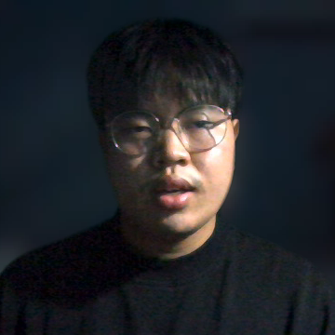
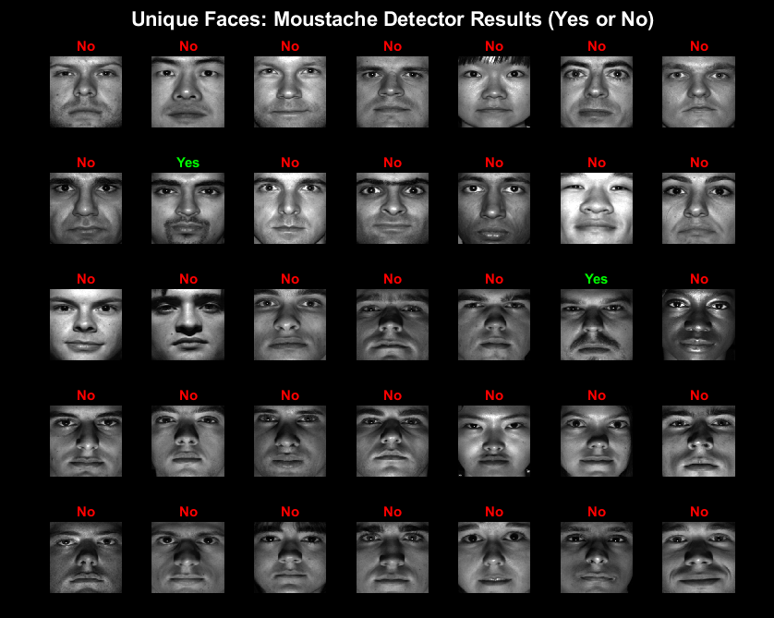
Last Sample: Unique Faces
Unique faces within the same dataset
Only 2 faces with a moustache
Accuracy: 100%
Notes:
We then tested unique faces. Looking at the figure *click* it shows a flawless accuracy of 100%.

Slide 4

Why we Deserve the Contract ↴
Seamlessly integrates machine learning to analyse real-world MRI data
Delivers an unprecedented approach towards a faster, earlier and more accurate diagnosis of brain disease.
Built for clinical impact with scalability and precision in mind
Notes:
If awarded the contract, our group can adapt this method with machine learning to real world MRI data to accurately detect brain diseases at machine-level speeds. This unprecedented approach could redefine how we diagnose complex brain diseases, revolutionising the healthcare industry.
Faster, earlier and more accurately than ever before.

Slide 5

THANK YOU
On behalf of:
Jean Warren Bulacan
Anish Kamalakkannan
Charlie McBride
Amber Xie
QUT
Notes:
Thank you for your time and consideration.

